Slide 1
Presentation On Universal Health Coverage - MIZORAM

Slide 2
Basic Statistics :
Sl. No. | Item | Mizoram
1 | Total population (Census 2011) (in lakhs) | 11
2 | Scheduled tribe population (%) | 94.5
3 | Decadal Growth (Census 2011) (%) | 23.48
4 | Crude Birth Rate (SRS 2007) | 18.2
5 | Crude Death Rate (SRS 2007) | 5.2
6 | Total Fertility Rate (NFHS-3) | 1.2
7 | Infant Mortality Rate (SRS 2012) | SRS | State HMIS
 |  | 35 | 30
8 | Maternal Mortality Ratio (SRS 2007 - 2009) | NA
9 | Sex Ratio (Census 2011) | 976
10 | Population below Poverty line (%) | 20.40
11 | Literacy Rate(Census 2011) | 91.33

Slide 3
Public Health Infrastructure:
Referral Hospital | District Hospital | Sub -District Hospital | CHC | PHC | AYUSH Hospital | Urban Health Center | Sub- Center | Sub -Center Clinic
1 | 8 | 2 | 12 | 57 | 8 | 5 | 370 | 135

Slide 4
Human resources:
Doctors |  |  | Staff Nurse |  | Health Super-visor | Health Worker (M) |  | Health Worker (F) |  | ASHA
State | NRHM | AYUSH | State | NRHM | State | State | NRHM | State | NRHM | NRHM
355 | 21 | 31 | 435 | 248 | 136 | 231 | 129 | 301 | 321 | 987

Slide 5
Achievement Highlights:
Operationalization of State Referral Hospital at Falkawn
RSBY Scheme
Mizoram State Health Care Scheme
AYUSH 10-Bedded Hospital in all the 8 Districts
50-Bedded AYUSH Integrated Hospital under construction at Thenzawl
Hospital Management Information System at Civil Hospital Aizawl

Slide 6
Achievements (Contd..)
Web enabled Stock Management System installed at Central Medical Store
Upgradation of Cancer Hospital to 40 bedded
Installation of Solar Power
- State Referral Hospital, Falkawn
- Dist. Hospital, Serchhip, Lawngtlai and Mamit.
Gynaecology Block at Civil Hospital
Strengthening of Cardiology Department at Civil Hospital, Aizawl

Slide 7
Projects in the pipeline:
Upgradation of Saiha District Hospital to 100 bedded.
Establishment of Medical College at Falkawn.
Establishment of 4 GNM Schools at Serchhip, Kolasib, Champhai and Saiha and 1 ANM School, Lawngtlai
Establishment of AYUSH Pharmacy College at Thenzawl
Upgradation of AYUSH Drug Testing Laboratory for Quality Control of AYUSH drugs at Zemabawk
Construction of 200 seater Hostel for MCON
Upgradation of Cancer Hospital to 100 bedded

Slide 8
Awards Received:
National Family Welfare Award by the Government of India -1987-1988
Second Best Performing State, NRHM North East Category by the Government of India - 2005-2010
Most Improved State: (Small State Category) by India Today - 2011.
JRD Tata Award for Best Performing State in Population and Reproductive Health Programme - 2011
Outstanding Performance in Programme Implementation of RSBY in the North East Region -2012
Outstanding Performance in Programme Implementation of RSBY in the North East Region- 2013

Slide 9
Measures taken for Effective Public Health Administration
State Public Health Cadre included in the Mizoram Health Service Rules
Centralized Public Grievance Redressal system (both manual and online) and Call Centre facilities established under NRHM
Every Department has placed a FAKSELNA BAWM for addressing public grievance
Implementation of the mandatory practice of Clinical Treatment Guidelines and the prescription of generic medicines as listed in the National List of Essential Medicines in all the Government Health Institutions is in the process

Slide 10
HEALTH FINANCING:
YEAR | APPROVED OUTLAY (in Rs./Lakhs) | ACTUAL EXPENDITURES | % Increase/Decrease
2010-2011 | 7105.00 | 7097.00
2011-2012 | 8775.00 | 8754.46 | (+)23.50%
2012-2013 | 8645.06 | 8645.00 | (-)1.48%
2013-2014 | 8938.12 | 8124.37 | (+) 3.38%

Slide 11
HEALTH REGULATIONS:
Mizoram Clinical and Health Establishment Act 2007.
Food Safety & Standard Act 2006.
Drugs & Cosmetics Act 1940
State Drug Policy drafting has been formulated for final approval by the Council of Ministers
Pre-conception & Pre-Natal Diagnostic Technique Act

Slide 12
Measures taken for Human Resource Development
Mizoram College of Nursing
Health Worker Training School
GNM Training School
AYUSH Doctors mobilized as Public Health Physicians at PHC, CHC and MSACS
Trainings conducted for Medical Officers and Staff Nurses
Training for ASHAs completed – Module 1-7
Initiative for career progression of ASHA into ANM by identifying ASHAs to be enrolled in Open School to complete XIIth Standard to enable them for ANM training.

Slide 13
Health Information Systems
Hospital MIS software in place at State Hospital.
Remaining 7 District hospital + 1 State Referral hospital to be covered
Innovative MIS successfully piloted in Khawbung PHC

Slide 14
Convergence and Stewardship
AYUSH Doctors are recruited in CHC/PHC/SDH/DH and also recruited as DPM in DAPCU, NACP.
Induced ownership at Village level by mobilizing Village Councils in Village level Health Program Management
Mizoram State AIDS Control Society (MSACS) effectively converged with National Rural Health Mission (NRHM)
Sensitization-cum-training programme for officials of NRHM (State level), District Programme Managers (DPM) and Block Programme Managers.
All Nationwide Health programs are mainstreamed under National Health Mission (NHM)
Role of NGO’s- YMA,MHIP etc
Partnership with the Church

Slide 15
Measures taken to ensure access to Medicines, Vaccines and Diagnostics
Multipurpose Vehicles available
Central Medical Store at State level
Storeroom at Districts and Primary Health Centres level
List of Essential Medicines under preparation

Slide 16
Towards Universal Health Coverage
Mizoram State Health Care Scheme and RSBY
Introduction of Sub-Center Clinics – 135
Human Ambulance : Stretcher
Ambulance provided to all PHCs for emergency transport
Two Wheeler Ambulance
GPS installed in all ambulances.

Slide 17
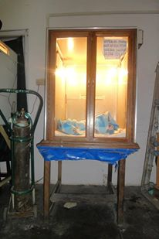
Towards Universal Health Coverage (contd)
Community Constructed PHC at Chhingchhip and Ratu
Community Constructed Sub Centre at Mawre
Improvised Wooden Radiant Warmer

Slide 19
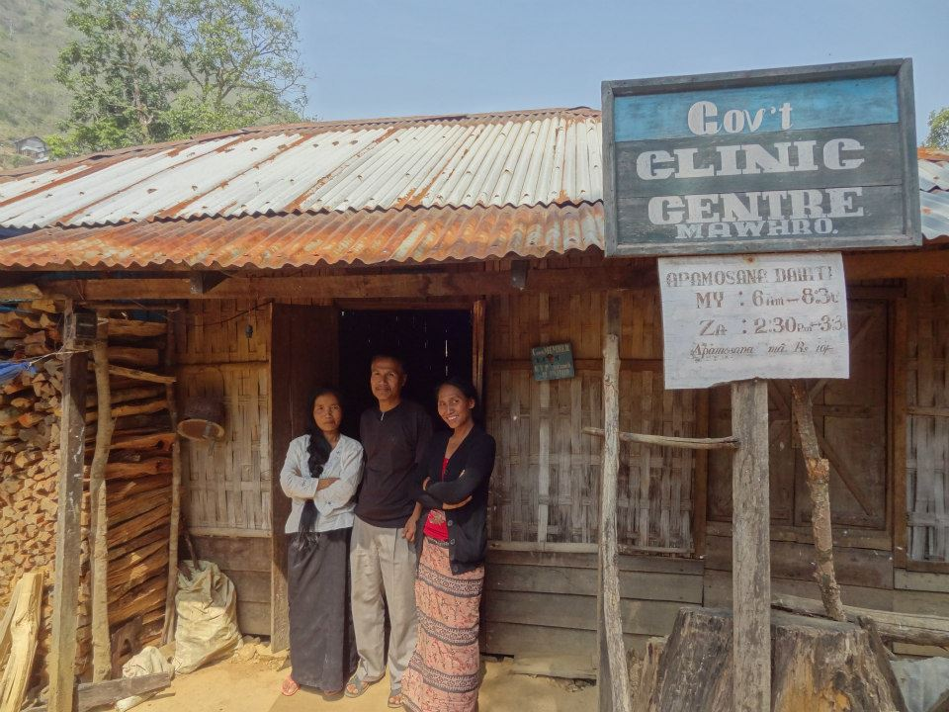
Improvised Sub Centre Clinic

Slide 20
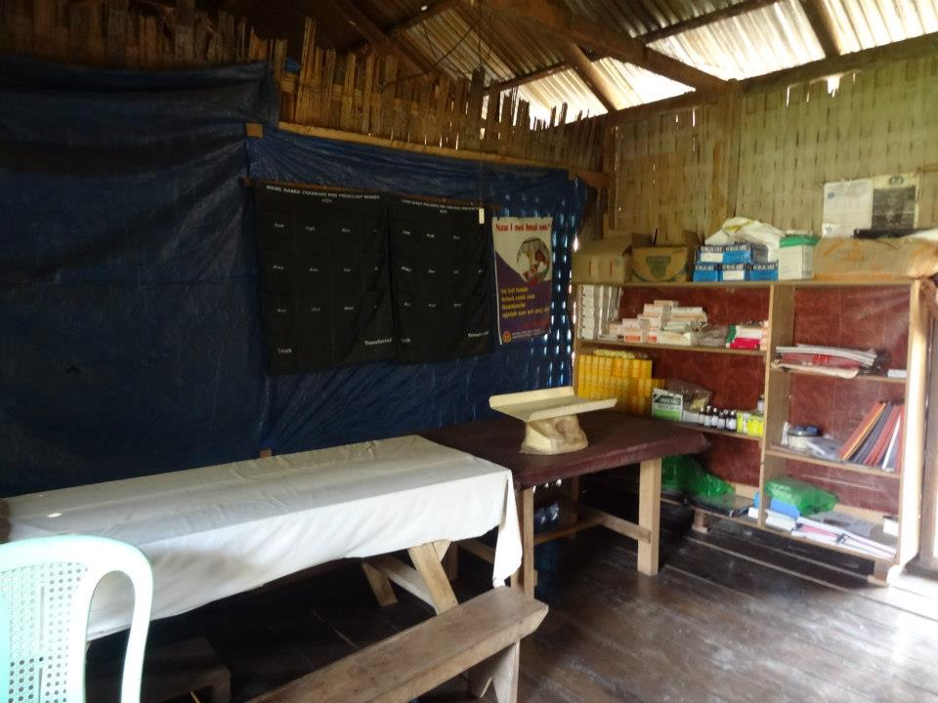
Improvised Sub Centre Clinic

Slide 21
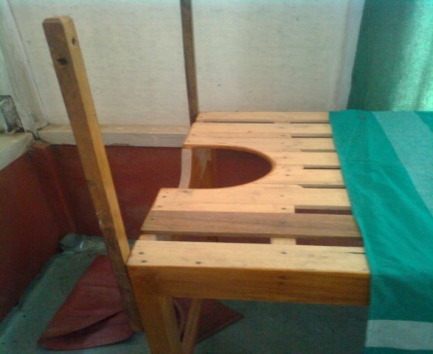
Towards Universal Health Coverage (contd..)
Improvised
Wooden Labour bed

Slide 22
Innovation: 2 Wheeler Ambulance

Slide 23
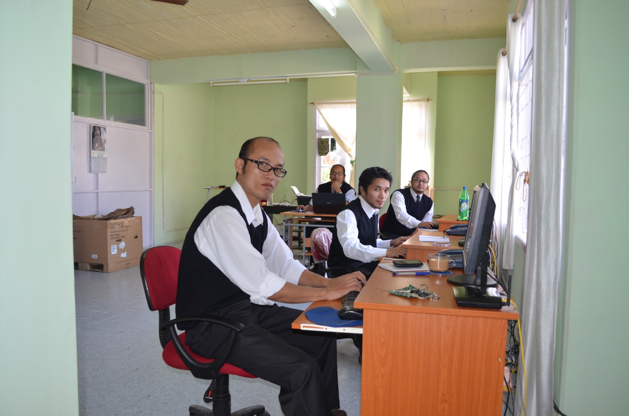
Call Centre for Health Service

Slide 24
Pilot District For Universal Health coverage - Kolasib
Health and Demographic profile of Kolasib District
Sl. No | Indicators
1 | Population | 83054
2 | Households | 12255
3 | Sex Ratio | 924
4 | Birth rate | 18.2
5 | IMR | 27
6 | MMR | 202
7 | District Literacy Rate | 94.54
8 | Scheduled Tribe | 86%
 |  | Source: Statistical Handbook 2012

Slide 25
Staff Position in the District
Sl. No | Staffs | Number
1 | Doctor | 18
2 | AYUSH Practitioner | 1
3 | Dental Surgeon | 7
4 | District Programme Manager(NRHM) | 1
5 | Nursing Superintendent | 1
6 | Ward Superintendent | 2
7 | Staff Nurse | 45
8 | Pharmacist | 10
9 | X Ray Technician | 6
10 | Lab Technician | 16
11 | Accounts Clerk | 9
12 | Driver | 11
13 | Group D staff | 70

Slide 26
Steps Taken For Universal Health Coverage Pilot District – Kolasib
Orientation of Medical Personnel.
Household survey
Guidelines on UHCs shared across the District.
Proposals and plans to be prepared with the District Officials
Convergence for all Health Programs led by District Deputy Commissioner

Slide 27
Thank you

