Slide 1
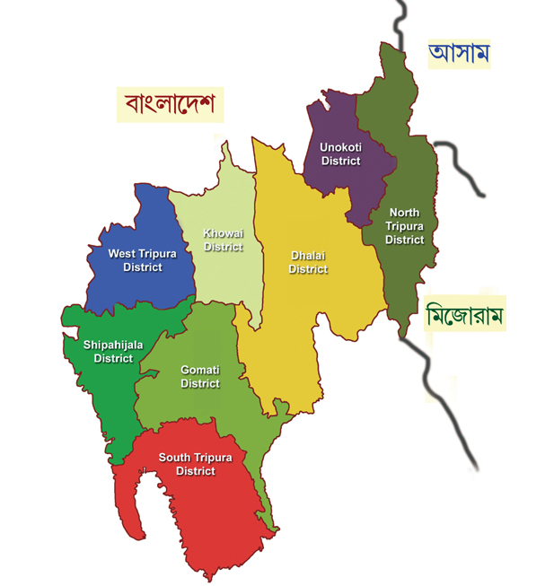
State Map
UNIVERSAL HEALTH COVERAGE AND INNOVATIONS IN HEALTH SECTOR OF TRIPURA.
Date : 20th January , 2014

Slide 2
OBJECTIVES
Equity in access to health.
Social Health Protection (Non-exclusion and non-discrimination).
Universal Health Access for all.
Comprehensive care that is rational and of good quality.
Protection of patients’ rights that guarantee appropriateness of care, patient choice, portability and continuity of care (Insurance / PPP with public sector).
Consolidated and strengthened public health provisioning.
Accountability and transparency.
Community participation and putting health in people’s hands
Gender insensitivity and solving gender discrimination issues.
Financial-risk protection.

Slide 3
Key Health Achievements of Tripura
Birth Rate reduced from 16.6 (2006) to 13.9 (2012).
Death Rate reduced from 6.3 (2006) to 4.8 (2012).
Growth Rate reduced from 10.3 (2006) to 9.2 (2012).
Infant Mortality Rate reduced from 36 (2006) to 28 (2012).
Total Fertility Rate is 1.7 since 2007.
Maternal Mortality Ratio reduced from 160 (2007-09) to 136 (2010-12) per Lakh Live Birth, for other category of state.
Sex Ratio increased from 950 (2001) to 961 (2011).
Source: SRS

Slide 4
Innovations in Health Sector.
ASHA Varosa Divas : ASHA Varosha Divas with single day payment system is organized in all Health Facilities on a fixed date of every month.
Telemedicine: Telemedicine project tackle huge scarcity of specialists in Radiology & Orthopedics in Tripura. Total 21 nodal centre & 3 referral centre are oerational covering all 8 districts. Since inception, 42549 patients have been treated till 31st December 2013.
Tele-Opthalmology: The project serves the rural population size of 27.16 lakhs people through 40 blocks Vision Centres in all districts of Tripura. 5 new centres are in pipeline.
VHND: Observed four times in a month, in all 1038 GP / ADC Villages in the State. Nutritional support given to mother and children with support of all departments involved for VHND. This programme has received “Prime Minister’s Award for excellence in Public Administration” for 2011-12 and also showcased in Planning Commission’s document.
Voluntary Blood Donation: Voluntary replacement is 99.06 %. In 2013-14 till December 583 camps organized through which 22680 unit blood collected.
E-Janani: Tracking Mother-Child by using Android Mobile, real time data collection is going on referring ROR more authentically by identifying beneficiary.

Slide 5
The Mandwi block of West Tripura has been selected for the purpose of UHC pilot wherein we have already started focussing on providing Universal health care services to the people since 2012. The Salient profile of the Block is as below:
Total Population : 58768
ST population : 54654
No. of ADC village : 24
No. of Primary Health Centre : 02
Sub-Centre functioning : 20
Sub-Centre under Construction : 02
No. of ASHA : 166

Slide 6
Health Status of Mandwi Block
Mandwi Block (Source : Health MIS) | 2012-13 | 2013-14 (as on December 2013)
Pregnant Women registered against the expected ANC | 82 % | 99 %
Institutional delivery out of total delivery | 78 % | 87 %
Newborns weighed at birth | 92 % | 95 %
Women receiving post partum check-up within 48 hours after delivery | 95 % | 100 %
Diarrhea and dehydration | 454 | 168
Malaria | 6 | 2
Communicable Diseases / Non Communicable Diseases:
Block is endemic area of Malaria, TB and Diarrhea.
25% to 35% of population suffers from various types of psychological issues because of myth and stigma.
Majority of cancer occurs in broad age group of 35 to 64 years.
Tobacco related cancers of head and neck region is around 21%.

Slide 7
Action Plan to Operationalise UHC
1. Convergence of Services Between NRHM & ICDS.
2. Autonomy for Single Pool of Resources ( like VHND, Health Camp, Untied Grant, Procurement of Medicine / Drug) by Block Care Committee through Joint Account.
3. Tracking trough MCTS in order to achieve cent percent delivery of public services.
4. Rewards / Appreciation :
Letter of Appreciation will be given to ASHA & concern ASHA Facilitator by ensuring 95 % coverage of ANC, Institutional Delivery, Home Based Neonatal Care, Immunization.
5. Career Progression: 10 % Seats has been reserved for ASHA for ANM training course. Preference will be given on Appreciation letter.

Slide 8
Action Plan to Operationalise UHC Continued..
6. Required regulatory mechanisms are in place as:
Clinical Establishment Act.
Drugs & Cosmetics Act.
PC & PNDT Act.
Food Safety & Standard Act,
Standard Treatment Protocol (STP)
Prescription Audit.
Civil Registration Act.
State Drugs Testing Laboratory (SDTL).
7. To Strengthen existing Health Administration & Services, along with Block Medical Officer, supportive staff with infrastructure & necessary equipments have been proposed.
8. Ownership & joint monitoring by PRI : Active involvement of PRIs for vibrant monitoring of Health Care Institutions in Tripura.

Slide 9
9. 20 Essential Packages of Services will be provided
Action Plan to Operationalise UHC Continued..
Safe Pregnancy & Delivery (Maternal and Reproductive Health Services ).
Newborn, Infant and Child Health Services.
Immunization.
Nutrition Related Services.
Contraceptive Services.
School & Adolescent Health Services.
Emergency Response and Patient Transport Services
Emergency Care.
Acute Communicable Disease: Fevers.
Acute Communicable Disease- Gastro-intestinal.
Chronic Communicable Disease-TB and Leprosy.
Chronic Communicable Disease: HIV
In Chronic Non- Communicable Disease: Hypertension, Diabetes, Epilepsy, Chronic Obstructive Pulmonary disease (COPD), Asthma.
Endemic/ Occupational problems (State Specific: e.g. JE, fluorosis, Meningococcal Meningitis etc) as appropriate.
NCD- Mental Health.
NCD- Cancers.
Eye Care.
Dental Care.
Basic Surgical Care.
General OPD.

Slide 10
Assistance we needed from GoI
At State level
Medicines, vaccines & diagnostic equipment's.
ToTs of Doctors, Paramedics from GoI like AIIMS etc.
Block Grant (Lump sum) to meet the NHM Gap.
Blood Banks at Sub-Divisional level.
Apart from that, Mandwi Block UHC plan has been prepared with an amount of Rs. 8.07 cr. & sent to MoHFW.

Slide 11
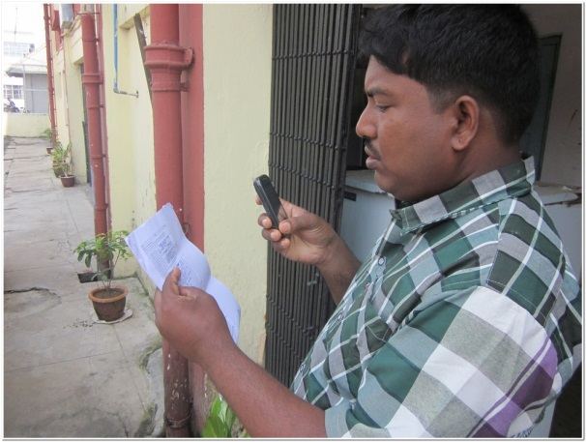
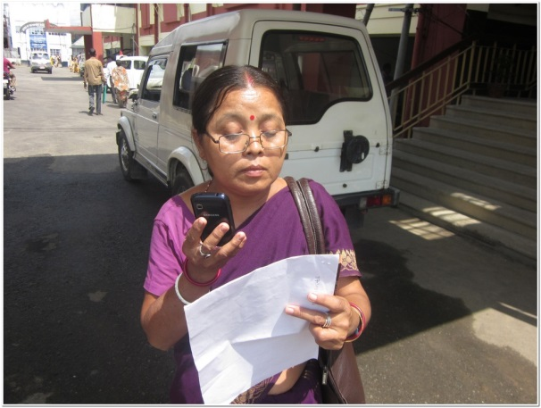
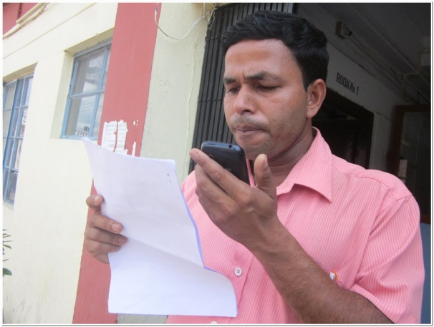
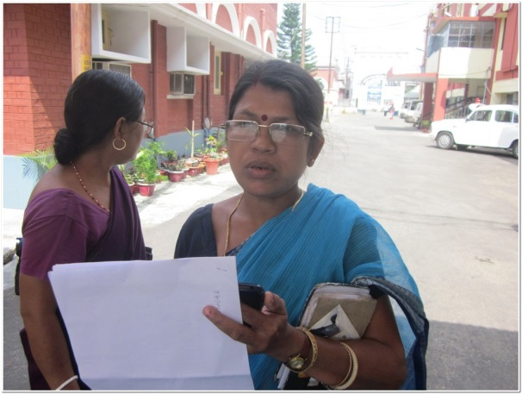
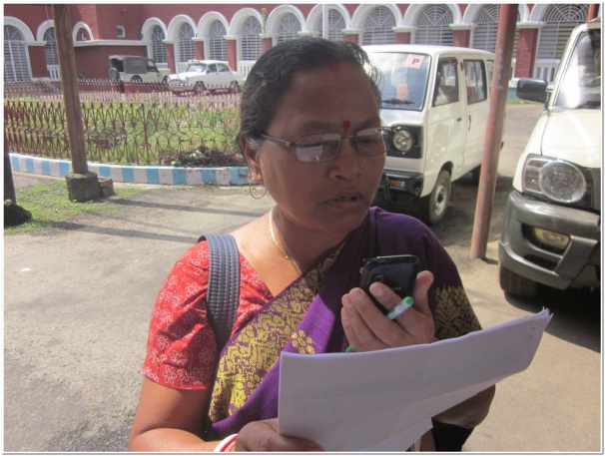
Voice Data capturing by MPWs of Mandwi Block
Thank YOU

