Slide 1
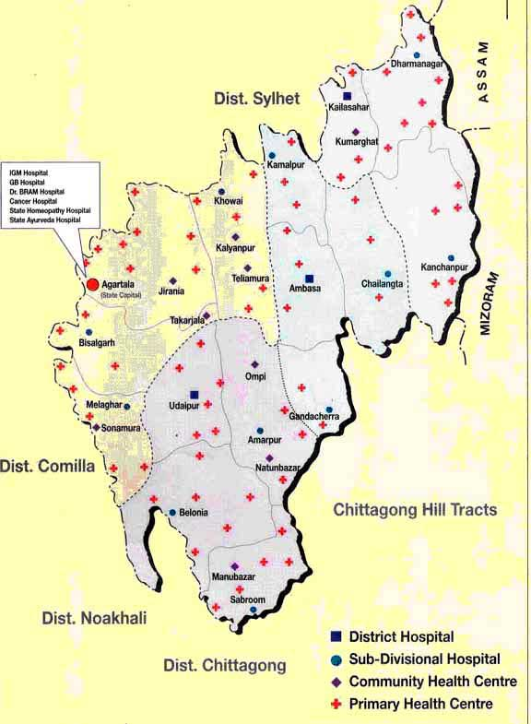
UNIVERSAL HEALTH COVERAGE AND INNOVATIONS IN HEALTH SECTOR IN TRIPURA
Date : 9th January, 2014

Slide 2
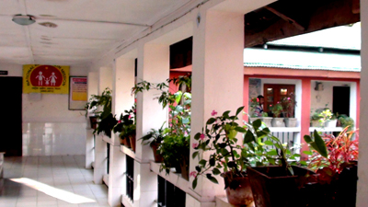
Tripura: A snap-shot
Population 2014: 3893229 (Census’11 including Growth Rate)
Rural Population : 83 %
Sex Ratio: 961
Pop. Density- per sq. km. :350
Literacy rate : 87.75 %
Administration:
Districts: 08
Sub-Divisions: 23
Blocks: 45
Gram Panchayet: 512
ADC Village : 528
AWC – 9906
AWC & SCs of Mandwi Block
Primary Health Centre

Slide 3
In the first phase, in Tripura on a pilot basis Mandwi Block has been chosen as the block was an obscure village located about 30 km north east of Agartala. The block was inhabited both by the Bengali and the Tribals.
Total Population | 54626
ADC Villages (No) | 24 nos.
PHC | 02 nos.
SUB-CENTRES (FUNCTIONING) | 20 nos.
SUB-CENTRES( UNDER CONSTRUCTION | 02 nos.
NO. OF ASHA | 166 nos.
NO. OF ASHA FACILITATOR | 10 nos.
NO. OF MPW ( MALE & FEMALE) | 28 nos.
Demography:
Mandwi R.D. Block | ST families | SC Families | OBC families | RM families | Others
 | 12775 | 261 | 214 | 359 | 128
 | ST population | SC Population | OBC Population | RM population | Others
 | 54654 | 1116 | 916 | 1466 | 616

Slide 4
Socio Economic Status:
Mandwi R.D. Block | BPL families | APL families | NREGA Job cards
 | 7544 | 5770 | 10271
Facility strength / Equipment / Human Resource / Daily load:
(Data Year: 2012-13)
Health Institution. | Facility strength |  |  |  | Equipment available |  |  |  |  | Staff In-position |  |  |  |  |  | Avg. monthly IPD load | Avg. monthly OPD load
 |  |  |  |  |  |  |  |  |  | MO |  |  | Tech. HR
 | Bed | 24 Hrs Elect. | 24 Hrs Water | Labour Room | Labour table | NBCC | Weigning Machine | Sterilizer | EDL | MO Allo | MO AYUSH | Dental MO | SN | Phar Allo | Lab.Tech
Borakha | 6 | Y | Y | Y | Y | Y | Y | Y | Y | 3 | 02 | 1 | 6 | 2 | 2 | 42 | 370
Mandai | 6 | Y | Y | Y | Y | Y | Y | Y | Y | 3 | 02 | 1 | 6 | 2 | 1 | 113 | 865

Slide 5
Key Deliverables : Health Situation Analysis:
Reproductive Child Health:
ANC registration is 93%,
1st trimester registration is 86% but 3rd trimester registration is 68%,
Haemoglobin % check up is only 30% of ANC,
IFA distributed to mother is 79% but Blood pressure check up is not recorded in HMIS report.
SBA attendance in home delivery is only 30% & PNC check up is 65%,
Family planning and Immunization coverage are 73% and 76% respectively.
Communicable Diseases / Non Communicable Diseases:
Block is endemic area of Malaria, TB and Diarrhea.
It has been observed that 25% to 35% of population to attend primary health care clinic suffers from various types of psychological problem. Most of them (>90%) remain untreated. Poor awareness, myth and stigma are related to it.
Majority of cancer occurrence broad age group is 35 to 64 years where 63.02% of total cancer cases are found. It was observed that Tobacco related cancers of head and neck region is around 21% in general both male & females. Again cervical cancer cases are 18.5% of total female cancers and breast cancer cases are 13.8%. Lung cancer cases in male are 18.8% of total male cancer cases and Gall Bladder Cancer cases in females are 9.6% of total female cancer cases.

Slide 6
Estimated Target (Baseline Assessment):
SL | Target of Beneficiary | Year 2013-14
1 | Estimated Eligible couples | 9286
2 | Estimated Pregnant Women | 859
3 | Estimated ANC registration | 773
4 | Estimated Delivery | 781
5 | Estimated Infant | 758
6 | ANC registered within 1st trimester | 696
7 | Pregnant women receiving 3 ANC | 503
8 | Institutional Deliveries | 664
9 | Caesarean Section | 100

Slide 7
The 20 Essential Package of Services to be assured under UHC Phase-1 at Mandwi Block:
Safe Pregnancy & Delivery (Maternal and Reproductive Health Services ).
Newborn, Infant and Child Health Services.
Immunization.
Nutrition Related Services.
Contraceptive Services.
School & Adolescent Health Services.
Emergency Response and Patient Transport Services
Emergency Care.
Acute Communicable Disease: Fevers.
Acute Communicable Disease- Gastro-intestinal.
11. Chronic Communicable Disease- TB and Leprosy.
Chronic Communicable Disease: HIV
In Chronic Non- Communicable Disease: Hypertension, Diabetes, Epilepsy, Chronic Obstructive Pulmonary disease (COPD), Asthma.
Endemic/ Occupational problems (State Specific: e.g. JE, fluorosis, Meningococcal Meningitis etc) as appropriate.
NCD- Mental Health.
NCD- Cancers.
Eye Care.
Dental Care.
Basic Surgical Care.
General OPD.
N.B: After receiving the approval with financial support from, 20 essential package of services will be declared by the state government in due course of time.

Slide 8
Regulatory Aspects:
SL | Name of Act / aspects | Year of Enactment / adoption | Latest Revised | Remarks / Status
a. | Clinical Establishment Act: | Act -1976 Rules 1979 |  | Sonography Clinics - District Magistrate & Collectors Others (Nursing Home, private clinics, laboratories, X - Ray clinics) - Chief Medical Officers
b. | Drugs & Cosmetics Act | 1940 | 2008 | Dy. Drug Controller is the Controlling Authority & assisted by 8 (Eight) Drug Inspectors.
c. | PC & PNDT Act | Act - 1994 Rules 1996 |  | Visits of District Inspection & Monitoring Committee are being held regularly District Advisory Committees reviewed twice in a month & informed to the Appropriate Authority for taking necessary action. At State level, State Level Multi Member Appropriate Authority headed by Director FW & PM ,regularly reviewed the status. State Supervisory Board headed by Hon’ble Minister, Health review the status twice in a year..
d. | Food Safety & Standard Act | Act’2006 Rules 2011 |  | Joint and Deputy Food Safety Commissioner have been notified. Public Analyst is in place Proposal for creation of posts of FSOs @ 2 in each jurisdiction for the new districts have also been cleared by the department. Strengthening of Regional Food Laboratory is in progress. Finalization of Rate of Equipment will be completed shortly.
e. | Standard Treatment Protocol (STP) & Prescription Audit |  |  | STP Finalized, Essential Drug Lists (EDL) has been revised and notified. Memorandum of availability of Free Drugs in public health facilities have been issued.
f. | Civil Registration Act |  |  | Available since 2001(vide Memorandum no F.10 (48) - SBHI / 99 & vide no F. 10 (48) – SBHI / 2001 )
g. | State Drugs Testing Laboratory (SDTL) |  |  | Proposal for strengthening of SDTL has been approved by the department for an amount of Rs. 1.07 crs.

Slide 9
PROPOSED HEALTH ADMINISTRATION FOR UHC:
Chairperson Panchayet Samitee
BDO
Block MO (Public Health)
MO/Ic (PHC)
PRI/ SHG / NGO
ANM/ MPW
ASHA / AWW

Slide 10
INNOVATIONS UNDER UHC
1. Convergence of Services:
Synergized working of ASHA & AWW by declaring AWC as convergence station at grass root level to ensure Ante Natal Care, Post Natal Care, Immunization, Family Planning, Counseling to Adolescents, IFA / Albendazole tablet distributution / Nutrition services / Mid Day Mill etc .DM’s have been made in charge of the Programme.
2. Ownership & joint monitoring by PRI : PRIs are very vibrant of monitoring Health Care Institutions in Tripura.
3. Autonomy for Single Pool of Resource:
For similar kind of activities like VHND, Health Camp etc. line departments are also providing fund support. However, to manage the resources effectively, Block Care Committee can use fund centrally by opening a Joint Account.
Based on yearly target beneficiary / disease burden, local Block Care committee can club all the resources of drugs to procure medicine as per EDL

Slide 11
INNOVATIONS UNDER UHC
Contd…
4. Tracking trough MCTS : In order to achieve cent per cent delivery of public services under preventive health care and nutrition related services, MCTS will be given preference.
5. Rewards / Appreciation:
Reward: Letter of Appreciation will be given to ASHA & concern ASHA Facilitator by BDO / Chairperson Panchayet Samitee subject to ensuring any of the three criteria mentioned below on her jurisdiction:
1. 95% 4 ANC coverage,
2. 95 % Institutional Delivery,
3. 95 % Home Based Neo Natal Care,
4. 95 % Immunization,
6. Career Progression: 10 % Seats reserved for ASHA for ANM training course. Preference will be given on Appreciation letter in future course of time under Govt. sector / promotion etc. wherever applicable.

Slide 12
Access to Medicine / Vaccines & Diagnostic Facilities : Supply Chain Management:-
Central Medical Store
Block Medical Store
PHC
Health Sub Centre
ASHA / AWC
N.B: Critical Gap Filling: From Untied Grant, critical patient ( BPL / ST / SC) will be referred in higher level facility (tertiary care: Pvt. Hospital if not available under Public sector) & treatment / referral cost will be reimburse based on actual expenditure. Registers with records should be maintained properly.

Slide 13
HEALTH FINANCING
SL | Activity | Budget in Lakhs
 |  | Non-Recurring | Recurring | Remarks / Justification
1 | Human Resource
 | Salary |  | 24 | 10 Admin. Staff average salary of Rs 20000/- ( Block Medical Officer & Ministerial Staff)
 | Capacity Building | 10 |  | 200 Service provider including ASHA & MO
2 | Strengthening of Health Infrastructure
 | Civil Works | 600 |  | Quarter facility / Repair & renovation of PHC & HSC ,Laboratory, Minor OT.
 | Furniture | 12 |  | Rs.1 Lakh per PHC & Rs.50,000 per HSC
3 | Logistics Supply
 | Drugs |  | 23 | Drugs for PHC @ Rs.6 Lakhs Per PHC per annum & Rs.50,000 per HSC per annum.
 | Equipments | 30 |  | Equipment shall include 1 nos X-Ray,01 USG, 02 Semi Auto Analyzer & Other Lab Equip.
 | Reagents |  | 5
 | Family Health Card |  | 1.37 | 13737 Family represents 52626 population required @ Rs. 10 / head

Slide 14
SL | Activity | Budget in Lakhs
 |  | Non-Recurring | Recurring | Remarks / Justification
4 | Nutritional Support. |  | 60 | PW & SAM Child around 1000 nos. @ Rs.500/- Per month
5 | Supervision & Monitoring |  | 2 | Mobility support , Office contingency & Meeting Expenditure
6 | IEC / BCC |  | 10 | IEC through SHG / NGO ( 2 nos) @ Rs. 2000 /- / monthIEC through SHG / NGO ( 2 nos) @ Rs. 2000 /- / month. IPC / GD once in a month to each ADC at Hut Days. Display materials / Leaflet / Miking /Poster / Booklet etc. based on need.
7 | Untied Grant |  | 10 | Untied Grant for Block Health Care Committee
8 | Establish Referral Linkage |  | 15 | Expected 300 referral per year (daily avg 01 referral) @Rs.5000/- per refer cases on average.
9 | Research Studies |  | 5
 | Sub Total | 652 | 154
Total Budget |  | Rs.807.37 Lakh
1. Fund requirement will be kept in the PIP separately. MOHFW may provide the fund.
2. Planning Commission may consider to provide SCA to operationalise UHC to entire
state.

Slide 15
Progress So Far…e-Janani : Tracking Mother-Child Dyad (for Mandwi Block of West Tripura) : Targets:
Identify target group- Mothers and Children.
Identify “Eligible Couples.”
Timely provision of health services.
Sharing data with ICDS.
Real Time data collection using Android mobile by health worker.
Data Analysis – Feed back mechanism
Identify specific causes of Maternal and Infant Mortality.
Involvement PRI members (Women).

Slide 16
Salient Features
Refer RoR and Marriage Register for beneficiary identification
Reaching up to habitation through Anganwadi Centres for maximum beneficiary coverage.
Using mobile telephony for Real Time Data Collection
Gathering host of new parameters for better analysis.
Generating work-plans and send mobile messages for ground workers.
Thorough analysis of statistical data- Block, PHC, Sub-Center, Anganwadi Center level
Achieving Exception-driven-intervention.

Slide 17
Innovations in Health Sector
ASHA Varosa Divas :
ASHA Varosha Divas is organized in all Health Facilities on a fixed date of every month. The topic of discussion and yearly calendar is communicated to all ASHAs well in advance. An honorarium of Rs.100/- is provided to each ASHA for attending the Divas and lunch, tea & snacks are provided in the meeting. All other incentives are providing to ASHA on the same date ( single day payment)
Telemedicine:
Telemedicine project operational in 21 nodal centre & 3 referral centre covering all 8 districts. Since inception 42549 patients have been treated till 31st December 2013. The project is being utilized for the people of rural & remote areas to tackle over huge scarcity of specialties in Radiology & Orthopedics in Tripura.
Tele-opthalmology:
The project serves a rural population size of 27.16 lakhs people 40 blocks in 4 undivided districts in the state of Tripura - 40 Vision Centres spread across the length and breadth of rural Tripura. Establishment of 5new centres are in pipeline.

Slide 18
Innovations in Health Sector
VHND:
VHND is organized four times in a month in all 1038 Gram Panchayet and ADC Villages in the State. Awareness discussion on 14 issues of preventive health care for the community, using the VHND FLIP CHART by Headmaster of School. Small quiz for mothers and children on health issues. Immunization of children and Ante Natal Check up. Weighing of children and plotting of WHO chart and health monitoring of pregnant mothers are done. Nutritional support given to mother and children with support of all departments involved for VHND
Health Camp through Helicopter ( In Three SDH: Kanchanpur, Longtoraivalley, Gandacheera):
The process has facilitated in serving those hard to reach areas/ hamlets including immunization services to the children of targeted age group where health facilities is yet to be witnessed by the inhabitants in selected eight sites of the State. In the year 2012-13 149 camp held & 5337 patients treated.
Voluntary Blood Donation: Voluntary replacement is 99.06 %. In 2013-14 till December 583 camps organized through which 22680 unit blood collected.
PRI’s involvement in Health Sector: Presently in 812 SC, 83 HCs & 18 CHC PRI members are involved through RKS, VHSNC .

Slide 19
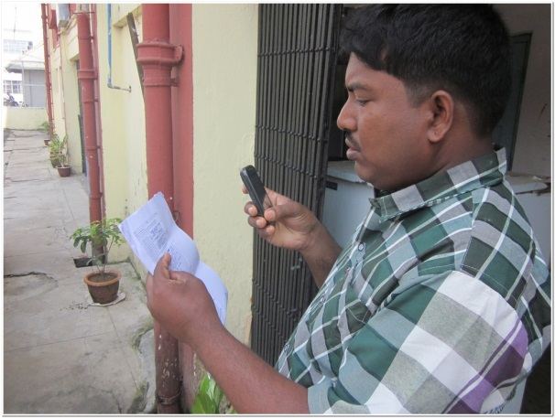
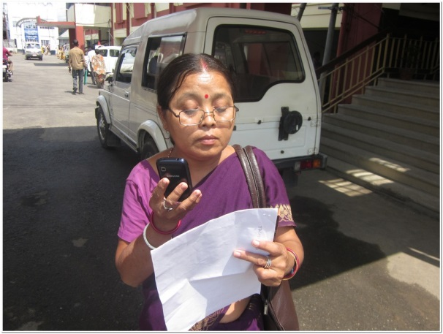
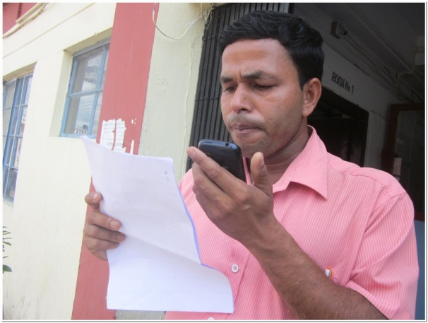
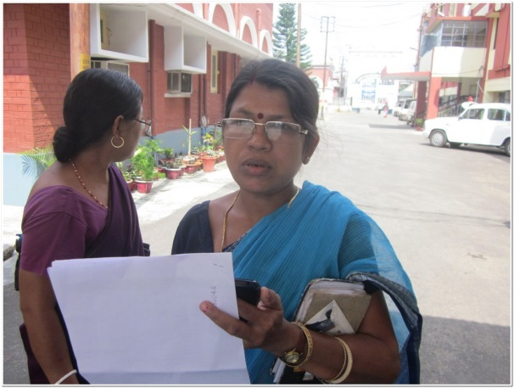
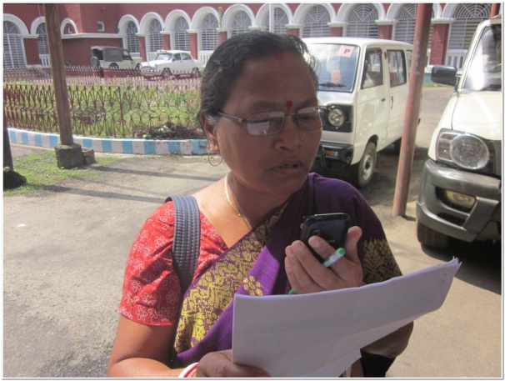
Voice Data capturing by MPWs of Mandwih Block
Thank YOU

